Slide 1
Knowledge
AKA How do we store things in memory?

Slide 2
Outline
Knowledge
Representation Types
Category Knowledge

Slide 3
Knowledge
What is knowledge?

Slide 4
Knowledge
Info about the world that is stored in memory
So, how could you go to a football game if you didn’t know what a football or game or stands were?

Slide 5
Representation Types
Definition: physical states that stand for some info
Parts:
  Intentionality
  Information-carrying
Notes:
Intentionally created to stand for something
Carry information about something

Slide 6
Memories and Representations
Chapter 4
The intentionality criterion: A representation must be constructed intentionally to stand for something else.
Much research shows that your brain stores information automatically, even when you’re not trying to fix it in your memory.
This suggests that you have the unconscious goal of storing information about experience, independent of your conscious goals.
It is as if the ability to store information is so important that evolution couldn’t leave the job to people’s conscious intentions. Instead, evolution entrusted part of the storage of information to unconscious automatic mechanisms in the brain.

Slide 7
Four Possible Formats for Representations
Chapter 4
Modality-Specific Representations: Images
Modality-Specific Representations: Feature Records
Amodal Symbols
Statistical Patterns in Neural Nets

Slide 8
Four Possible Formats for Representations
Chapter 4
One aspect of a representation is its format.
Format not only refers to the elements that make up a representation and how these elements are arranged, but also relies on characteristics of the processes that operate on them to extract information.
As we will see, representations may be modality specific, that is, they may make use of perceptual or motor systems, or they may be amodal, residing outside the perceptual and motor modalities.

Slide 9
Chapter 4
Modality-Specific Representations: Images
An image has three elements, which taken together determine its content: a spatiotemporal window, storage units, and stored information.
Spatially, there are infinitely many pictures that a camera could take of the same scene, depending on its position relative to the scene here the image has cut off the gifts and the table legs.
Temporally, the scene is not captured continuously over time, just in one time slice when the shutter is open.
Thus, any image is defined to some extent by its spatiotemporal window.

Slide 10
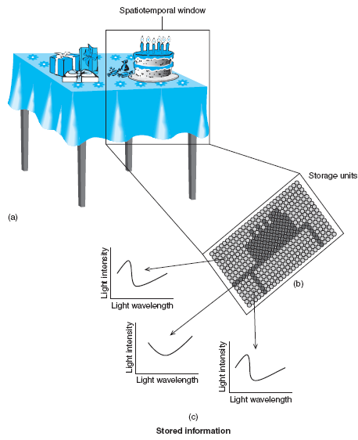
Chapter 4
A spatiotemporal window of the information captured in the viewed scene.
Within the spatiotemporal window an array of pixels captures the light information present.
Each pixel stores information about the intensity of light across the range of light wavelengths to which the pixel is sensitive.
Together the stored information across pixels in the spatiotemporal window constitutes one possible image representation of the birthday scene.

Slide 11
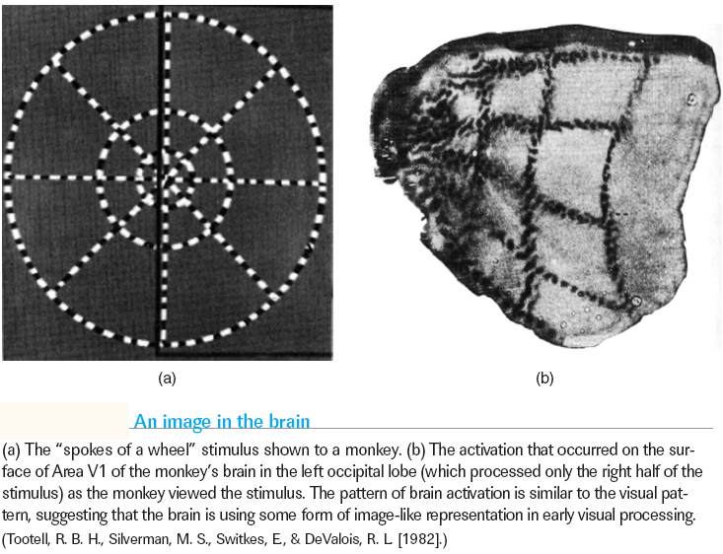
Chapter 4
Modality-Specific Representations: Images

Slide 12
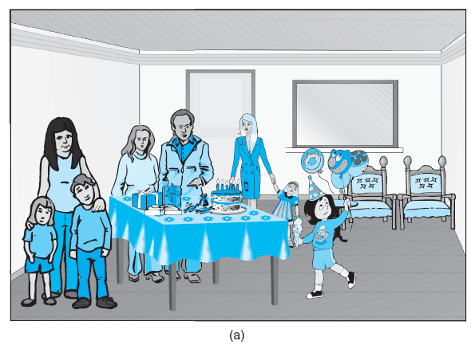
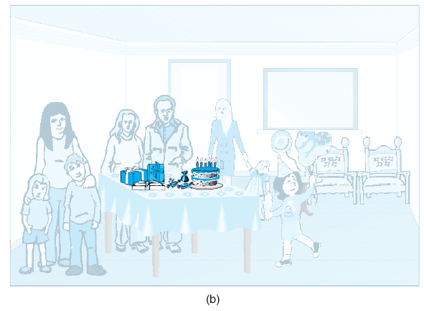
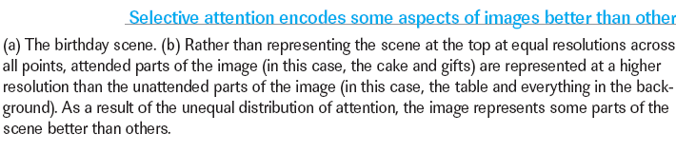
Chapter 4
Modality-Specific Representations: Images

Slide 13
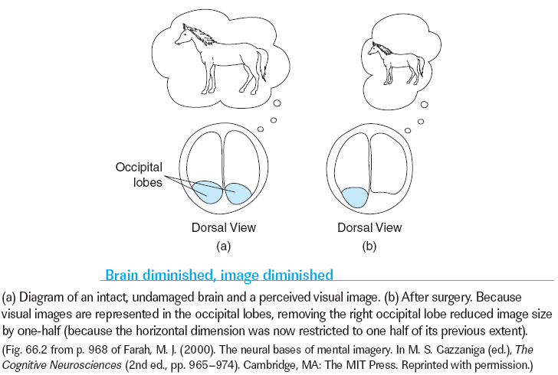
Chapter 4
Modality-Specific Representations: Images
Click here for A CLOSER LOOK

Slide 14
Chapter 4
Modality-Specific Representations: Feature Records
At the heart of sophisticated representation lies the categorization of meaningful entities.
A meaningful entity is an object or event that plays an important role in an organism’s survival and pursuit of goals.
In contrast, a pixel is a relatively meaningless entity. We don’t just want to know whether light impinges on a particular point in space; we want to know what the patterns of pixels—or areas of neural activation— represent in the world.

Slide 15
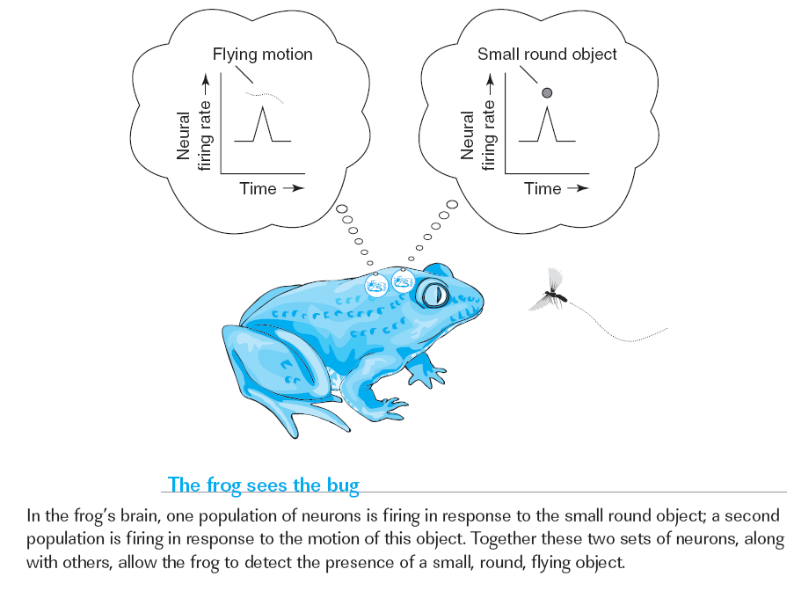
Chapter 4
Modality-Specific Representations: Feature Records
Notes:
Early and important work (Lettvin et al., 1959) showed that neurons in the frogs visual system respond differentially to small objects moving within the frog’s visual field. These researchers inserted electrodes into individual neu­rons of a frog’s brain and then varied the stimulus—sometimes a round stationary object, sometimes a moving object—to the frog’s eyes. They found that some neu­rons fire in response to small round objects (largely independent of motion), whereas others fire in response to object movement (largely independent of the object). Different populations of neurons appeared to detect different types of information in the visual field. (p. 161)

Slide 16
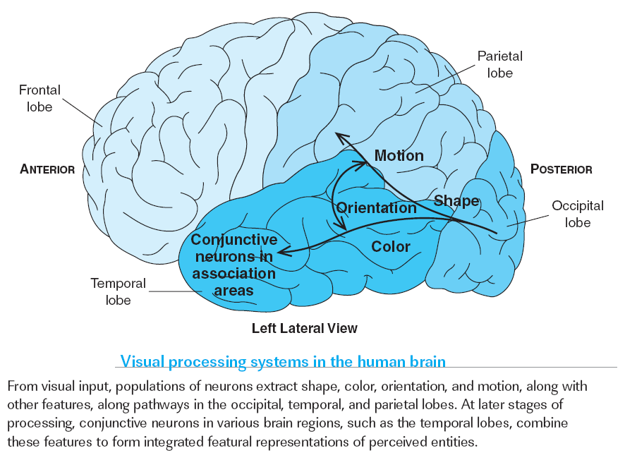
Chapter 4
Modality-Specific Representations: Feature Records
Notes:
Early and important work (Lettvin et al., 1959) showed that neurons in the frogs visual system respond differentially to small objects moving within the frog’s visual field. These researchers inserted electrodes into individual neu­rons of a frog’s brain and then varied the stimulus—sometimes a round stationary object, sometimes a moving object—to the frog’s eyes. They found that some neu­rons fire in response to small round objects (largely independent of motion), whereas others fire in response to object movement (largely independent of the object). Different populations of neurons appeared to detect different types of information in the visual field. (p. 161)

Slide 17
Chapter 4
Amodal Symbols
Modality-specific representations reside in the perceptual and motor systems of the brain, and are thus perceptually related to the objects they represent.
Is it possible that amodal representations exist that are built from arbitrary, abstract symbols?
The dominant view is “yes,” but the question is still open.

Slide 18
Chapter 4
Amodal Symbols
A frame is a structure, rather like an algebraic expression, that specifies a set of relations that links objects in the environment.
A semantic network represents essentially the same relations and objects in diagram form.
A property list names the characteristics of the entities belonging to a category.

Slide 19
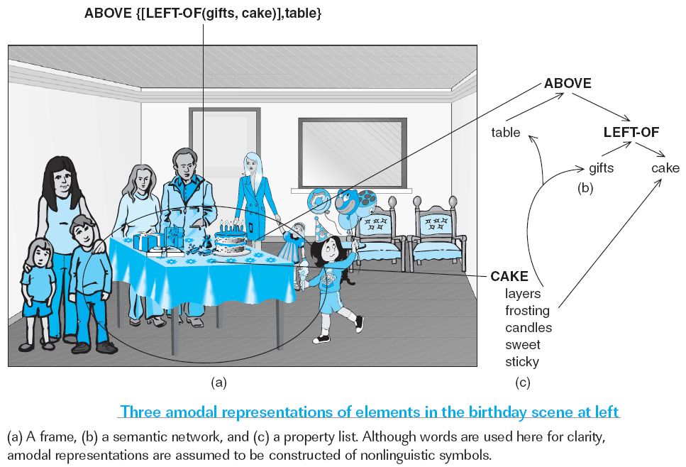
Chapter 4
Amodal Symbols

Slide 20
Chapter 4
Statistical Patterns in Neural Nets
Another possible means of representation is the neural net, a construct in which the cake in the birthday scene is represented by a statistical pattern such as 1100101000101.
This offers greater scope than the amodal system for two reasons:
(1) The statistical approach has a natural neural interpretation that makes it a plausible candidate for biological representation.
(2) Multiple statistical patterns can represent the same category.
Simulation: a statistical pattern can reactivate image and feature information even after the original scene is no longer present

Slide 21
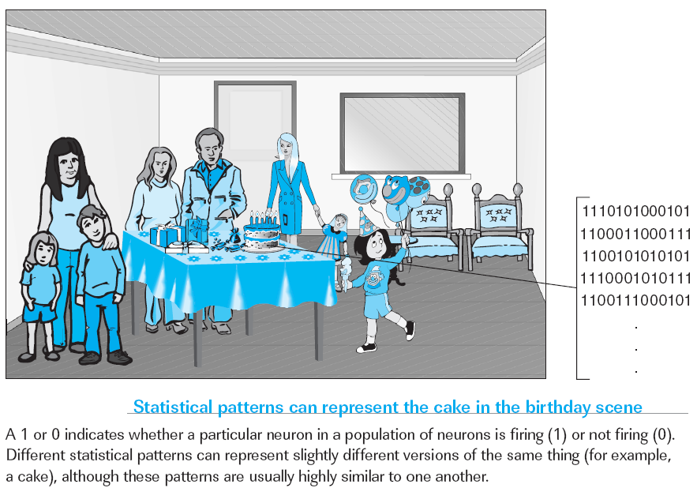
Chapter 4
Statistical Patterns in Neural Nets

Slide 22
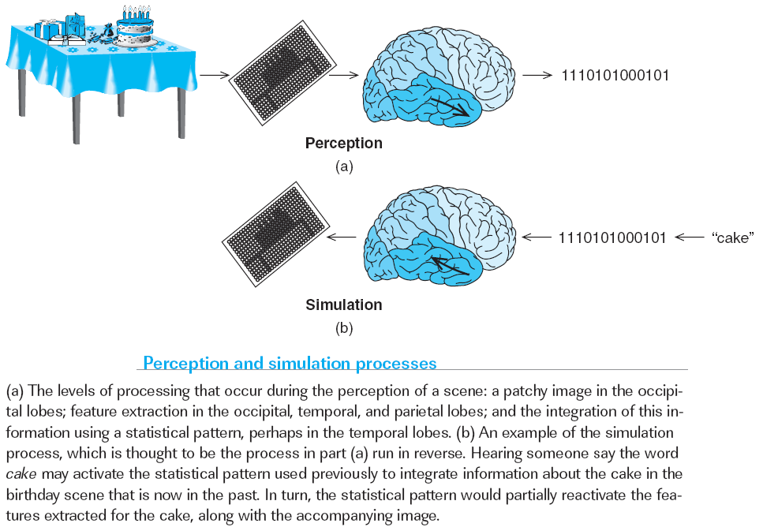
Chapter 4
Statistical Patterns in Neural Nets

